Slide 1
A FRAMEWORK TO EVALUATE MARINE RESERVES IN MEXICO
Caio Faro, Jael Martinez, Juan Carlos Villasenor and Melaina Wright
TURFeffect
Fall Review Meeting
November 03, 2016

Slide 2
Objectives
1. Determine a set of biophysical, socioeconomic and governance indicators that can be used to evaluate the effectiveness of no-take marine reserves in Mexico. 2. Use the selected indicators to propose a framework for evaluating the effectiveness of no-take marine reserves in Mexico. 3. Develop an English/Spanish guidebook with the selected indicators that walks the user through implementing our framework.

Slide 3
Summer and Fall Progress
Data Collection and
Started during Spring quarter and continued over the summer
Juan Carlos’ internship
Jael and the ETJ
Indicators and Reserves’ Objectives
Redefined indicators
Matched indicators with objectives

Slide 4
Tipo | Objetivos | Biophysical |  |  |  |  |  | Socio-economical |  |  | Governance
 |  | Diversity index (Richness, Shannon, Simpson) | Density of mature organisms | Density * | Natural Disturbance | Trophic level | Biomass * | Landings | Income from landings | Alternative economic opportunities | Access to the fishery | Number of fishers | Legal recognition of reserve | Reserve type | Illegal harvesting | Management plan | Reserve enforcement | Size of reserve | Reasoning for reserve location | Membership to fisher organizations | Type of fisher organizations | Representation
ZRP | Recuperar especies de interés comercial |  | * | * | * |  | *
 | Conservar especies en régimen de protección especial |  | * | * | * |  | *
 | Mejorar la productividad pesquera en aguas adyacentes |  |  | * | * |  | * | * | *
 | Evitar que se llegue a la sobreexplotación |  | * | * | * |  | *
 | Recuperar especies sobreexplotadas |  | * | * | * |  | *
 | Contribuir al mantenimiento de los procesos biológicos (crianza, reclutamiento, crecimiento, reproducción, alimentación) | * | * | * | * | * | *
 | Preservar el hábitat de las especies pesqueras

Slide 5
Summer and Fall Progress Survey
Survey
Application over the summer
Review and Improvement
New tests in 1 week
Data Analysis
Changed Methods
Improved analysis
Deciding how to input Governance indicators

Slide 6
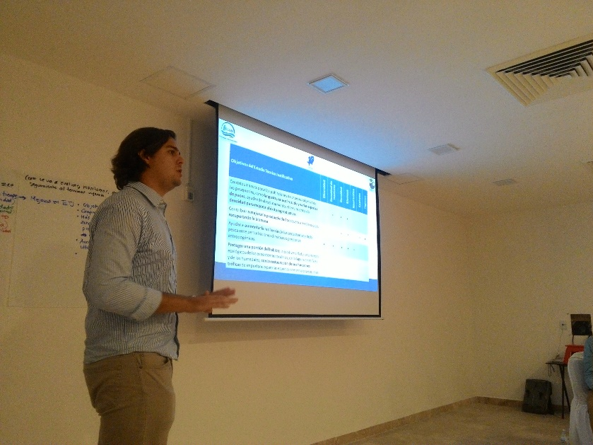
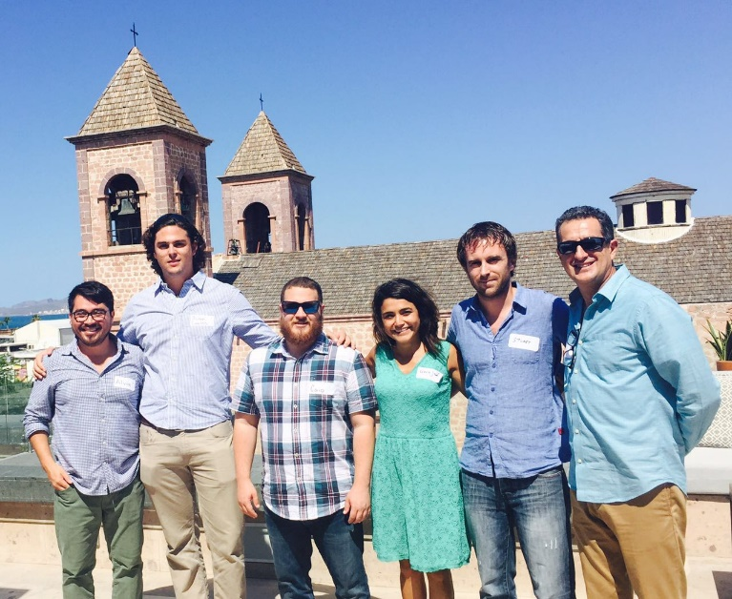
Summer and Fall Progress Outreach and Feedback
Outreach and Feedback
Workshop “ Evaluacion y Seguimiento de Zonas de Refugio en Mexico” – La Paz, Mexico.
Presentation of list of indicators and preliminary results from Quintana Roo.
Group activity to debate possible indicators in the evaluation of fishing refugees.

Slide 7
Objectives
1. Determine a set of biophysical, socioeconomic and governance indicators that can be used to evaluate the effectiveness of no-take marine reserves in Mexico. 2. Use the selected indicators to propose a framework for evaluating the effectiveness of no-take marine reserves in Mexico. 3. Develop an English/Spanish guidebook with the selected indicators that walks the user through implementing our framework.

Slide 8
Next Steps – Fall Quarter
Field trip to El Rosario, Mexico – November 10 to 13, 2016
Guidebook outline
Shiny app (beta version)
Final Report outline

Slide 9
Upcoming Academic Deliverables
Academic defense – March 3 or 10, 2017
Final report – March 24, 2017
Project brief and poster – April 14, 2017
Public presentation – April 21, 2017

Slide 10
Questions?

Slide 11
Thank you!

